Slide 1
Distributed Computer Systems
CT024-3-3-DCOMS and VE
Security Issues

Slide 2
TOPIC LEARNING OUTCOMES
At the end of this topic, you should be able to:
Understand about Secure communication
Explain about the authentication
Understand about the cryptography
Discuss about the digital signature

Slide 3
Contents & Structure
Define Security in DS
Secure Communication
Discuss about the Authentication
Type of threats
Security mechanism
Cryptography
Digital Signature

Slide 4
Recap From Last Lesson
We have learned about Blockchain Concepts
Uses of blockchain
Future in blockchain

Slide 5
Security
Strategies for securing Distributed Systems
Generally very similar to techniques used in a non-distributed system, only much more difficult to implement …
Difficult to get right, impossible to get perfect!

Slide 6
Security Topics
Providing a secure communications channel – authentication, confidentiality and integrity.
Handling authorization – who is entitled to use what in the system?
Providing effective Security Management.
Example systems: SESAME and e-payment systems.

Slide 7
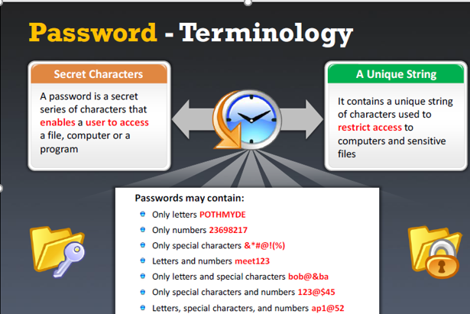
What is Password?

Slide 8
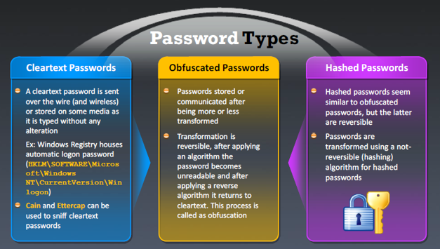
Password Types

Slide 9
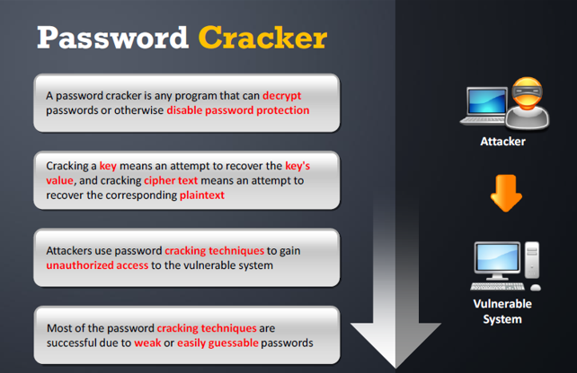
Example: Password Cracker

Slide 10
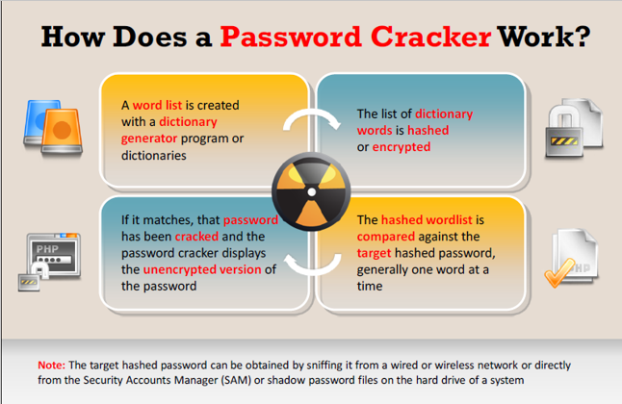
How does a Password Cracker Work?

Slide 11
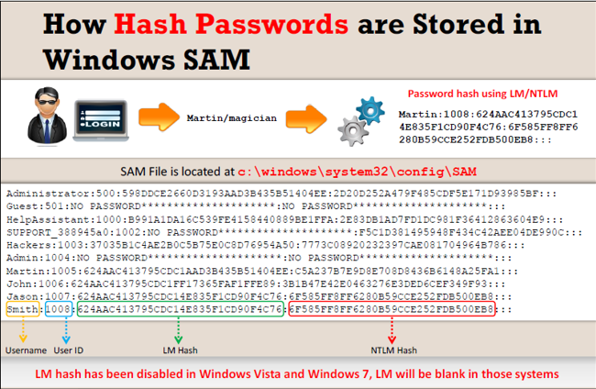
How does the Hash Password Stores?

Slide 12
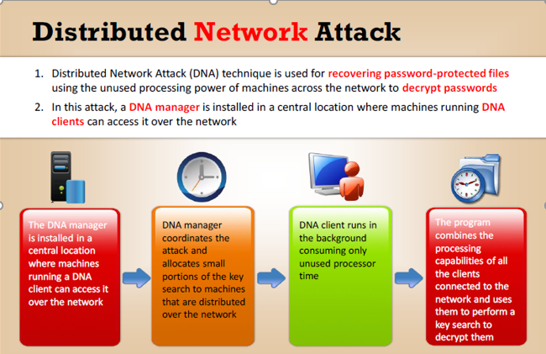
Distributed Network Attack

Slide 13
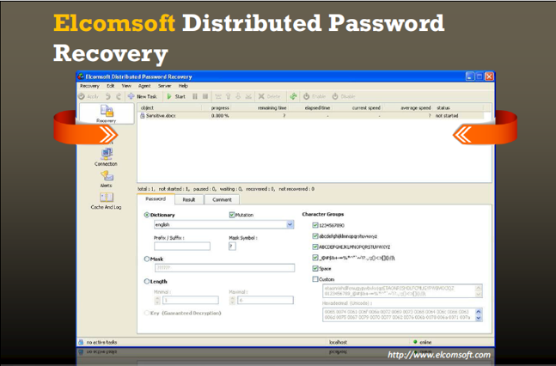
Elcomsoft.com

Slide 14
Type of Threats
Interception – unauthorized access to data.
Interruption – a service becomes unavailable.
Modification – unauthorized changes to, and tampering of, data.
Fabrication – non-normal, additional activity.

Slide 15
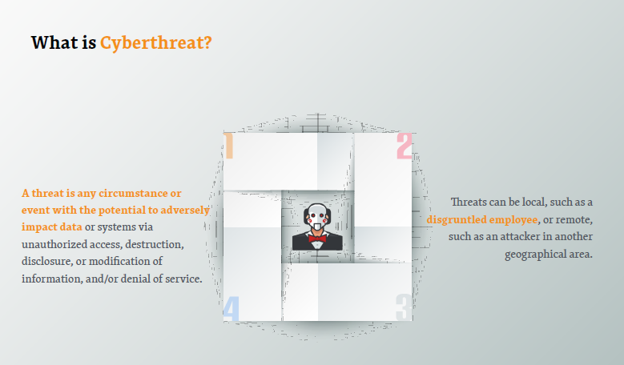
What is Threat?

Slide 16
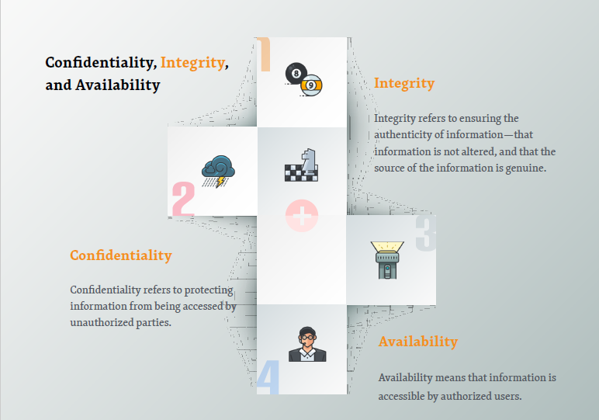
Security

Slide 17
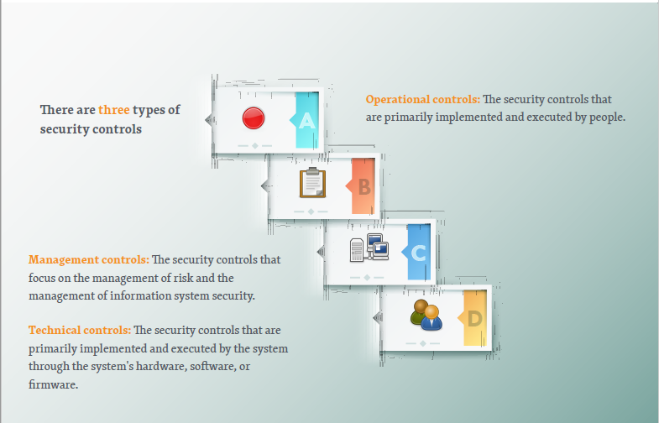
Security Controls

Slide 18
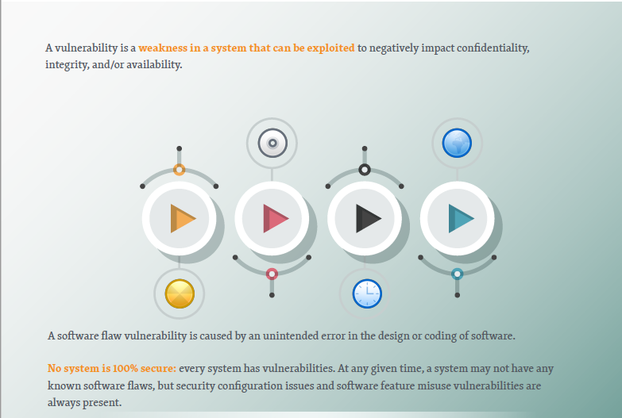
Vulnerability

Slide 19
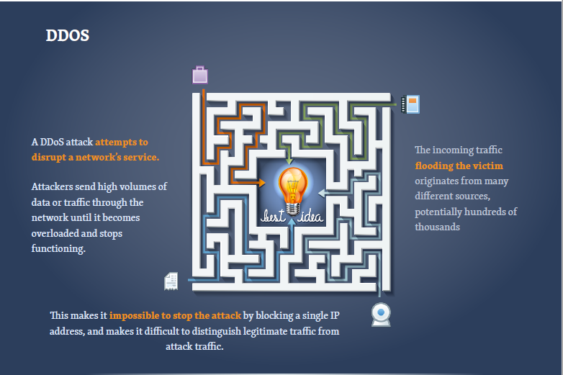
DDoS (Distributed Denial of Service)

Slide 20
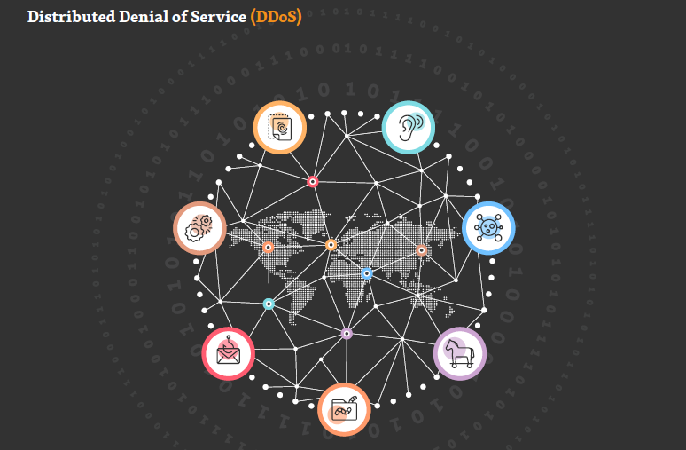
DDoS

Slide 21
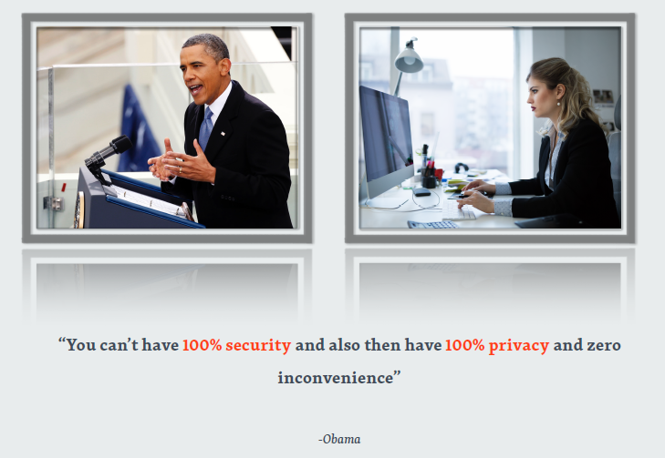
No 100% Security

Slide 22
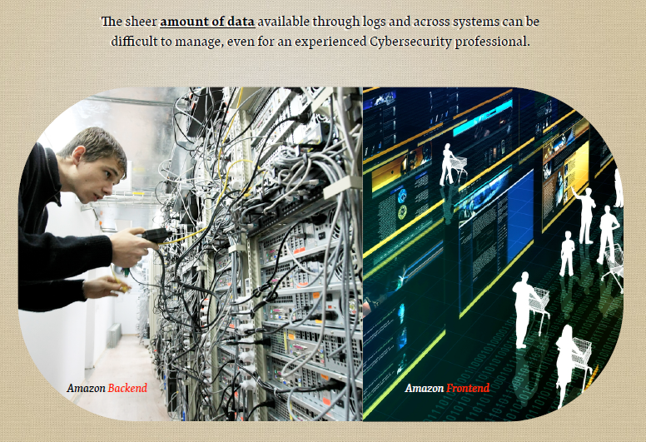
Example: Amazon

Slide 23
Security Mechanisms
Encryption – fundamental technique: used to implement confidentiality and integrity.
Authentication – verifying identities.
Authorization – verifying allowable operations.
Auditing – who did what to what and when/how did they do it?

Slide 24
Key Point
Matching security mechanisms to threats is only possible when a Policy on security and security issues exists.

Slide 25
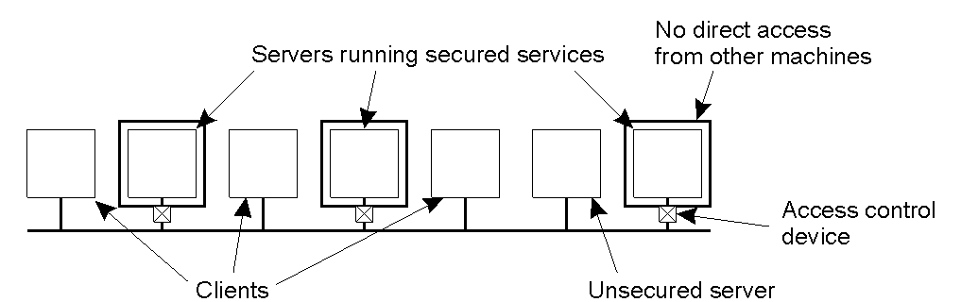
Distribution of Security Mechanism
The Trusted Computing Base (TCB) is the set of services/mechanisms within a distributed system required to support a security policy.

Slide 26
Security Mechanism
Fundamental technique within any distributed systems security environment:
Cryptography

Slide 27
Types of Cryptosystems
Symmetric: often referred to as conventional cryptography, defined as:
P = D_{k} ( E_{k} ( P ) )
Asymmetric: often referred to as public-key cryptography, defined as:
P = D_{kd} ( E_{ke} ( P ) )

Slide 28
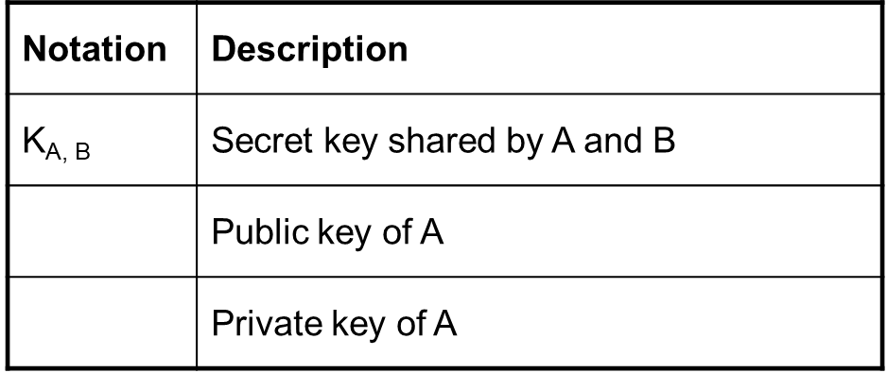
Notation of Cryptography

Slide 29
Applications of Cryptography
Authentication.
Message Integrity.
Confidentiality.

Slide 30
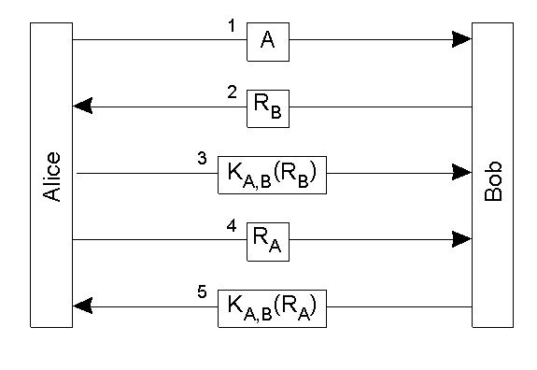
Authentication
🔄 Steps in the Protocol
Alice → Bob: A
Alice sends her identity ("I am Alice") to Bob.
Bob → Alice:
Bob generates a random number RBR_BRB​ (challenge) and sends it to Alice.
Purpose: To check if Alice really knows the secret key.
Alice → Bob:
Alice encrypts Bob’s challenge using the shared key and sends it back.
Bob can verify it because he also knows the shared key.
✅ This proves Alice is really Alice.
Alice → Bob
Now Alice challenges Bob. She sends her own random number ​.
Bob → Alice:
Bob encrypts Alice’s challenge using the same shared key and sends it back.
✅ This proves Bob is really Bob.
Authentication based on a shared secret key, using a ‘challenge response’ protocol. Note: R is a random number.

Slide 31
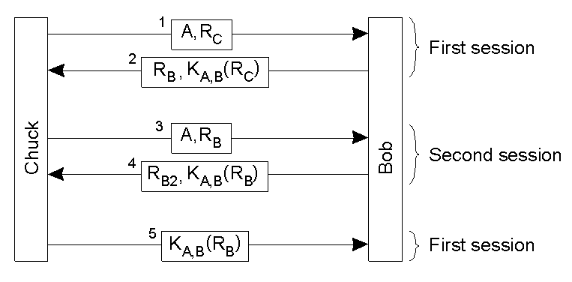
An Authentication Attack
The ‘reflection attack’. Chuck wants Bob to think he is Alice, so he starts up a second session to trick Bob.

Slide 32
More on Secure Channels
In addition to authentication, a secure channel also requires that messages are confidential, and that they maintain their integrity.
For example: Alice needs to be sure that Bob cannot change a received message and claim it came from her. And Bob needs to be sure that he can prove the message was sent by/from Alice, just in case she decides to deny ever having sent it in the first place.
Solution: Digital Signing.

Slide 33
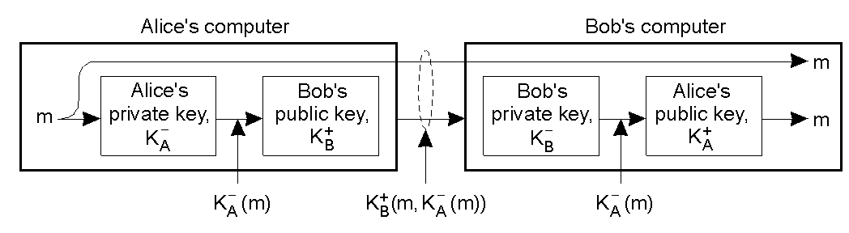
Digital Signatures
Digital signing a message using public-key cryptography.
This is implemented in the RSA technology.
Note: the entire document is encrypted/signed - this can sometimes be a costly overkill.

Slide 34
Access Control
Authorization is the process of
“granting access rights” to a user/process.
Access Control is the process of
“verifying access rights” for an authorized user/process.

Slide 35
Review Questions
What is Threat?
How to set Password?
Security Issues

Slide 36
Summary / Recap of Main Points
Providing a secure communications channel – authentication, confidentiality and integrity.
In addition to authentication, a secure channel also requires that messages are confidential, and that they maintain their integrity by using digital signature
Access Control is the process of
“verifying access rights” for an authorized user/process.

Slide 37
What To Expect Next Week
In Class
Preparation for Class
https://lastpass.com
https://www.greynoise.io
https://checkusernames.com
https://builtwith.com
https://deepfakesweb.com
https://breakyourownnews.com
https://haveibeenpwned.com
https://www.online-toolz.com/tools/text-encryption-decryption.php
RMI
Steps in RMI
Implementation of RMI

